Slide 1
Additional Design Patterns for Games
For CSE 3902
Matt Boggus

Slide 2
Flyweight
An object that minimizes memory use by sharing as much data as possible with other similar objects
Frequently used in graphical applications
Font file
Image file for sprite drawing
3D model file

Slide 3
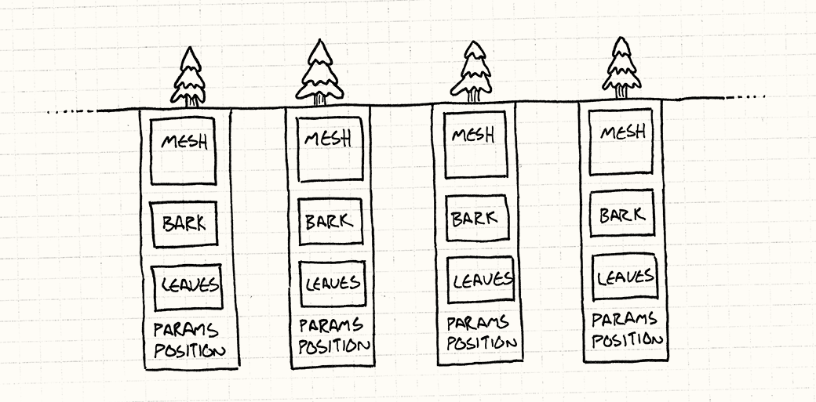
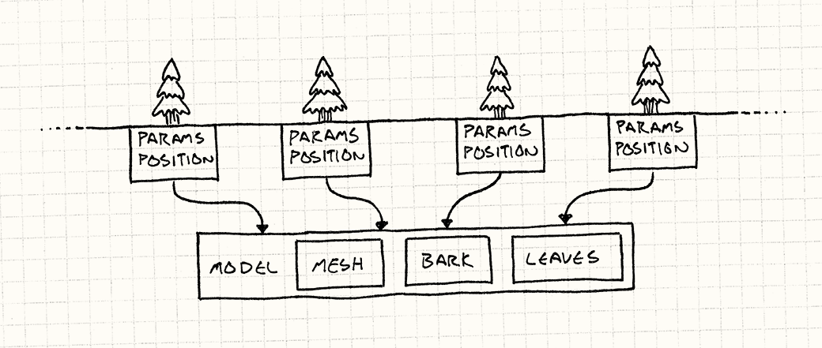
Flyweight example – 3D tree model
Instances
Instances with shared 3D model
Images from gameprogrammingpatterns.com

Slide 4
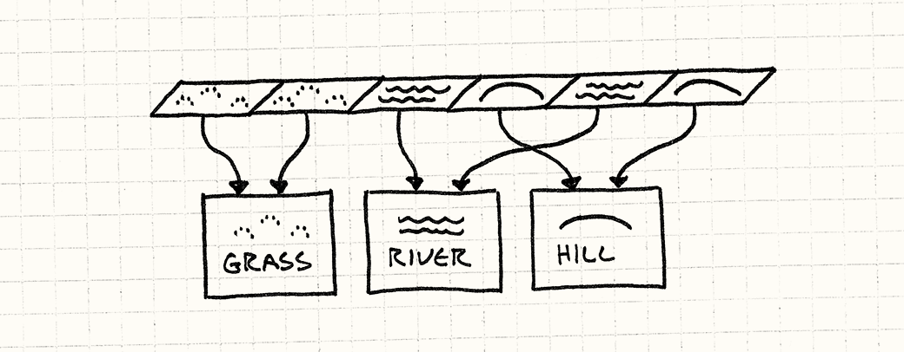
Flyweight example – level tiling
Image from gameprogrammingpatterns.com

Slide 5
Object pool
Use a set of initialized objects kept ready to use (a pool) instead of allocating and destroying them on demand.
Allocation -> request an object from the pool
Destroying -> return an object to the pool
Examples:
Projectiles
Infinitely spawning enemies

Slide 6
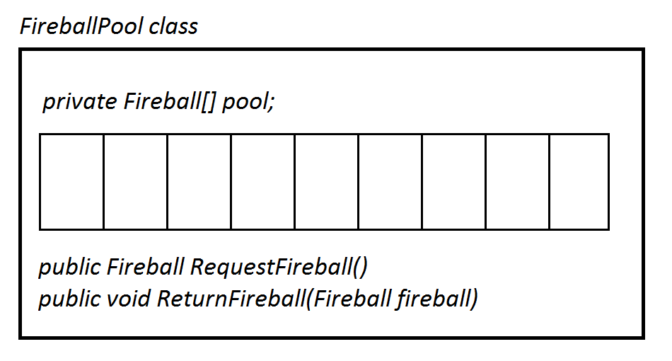
Object pool example

Slide 7
Builder
Build an object piece by piece instead of all at once
Avoids needing a large number of different constructors
A builder object receives each initialization parameter step by step and then returns the resulting constructed object at once
Example:
Using an EnemyBuilder called enemyBuilder
enemyBuilder.setPosition (10,10);
enemyBuilder.setSprite(Goomba);
enemyBuilder.setAttackSides(left,right,bottom);
…etc…
enemy = enemyBuilder.getResult();
Also can be used in dependency injection

Slide 8
Memento
Store the state of an object and allow for restoring the object to that state when needed
Originator (example: Level)
Create a memento object representing its current sate
Use a memento object to restore its previous state
Memento
Stores internal state of the Originator object.
Caretaker (example: Game)
Stores memento objects
Pass originator a memento to revert to an earlier state
Revert to previous frame
Revert to last checkpoint

Slide 9
Entity component system (main idea)
Every GameObject is an Entity
Empty object, usually has a unique id
Attach domain behavior to each Entity as a Component
Example domains: position, drawing, collision detection and response, physics, sound
Main game loops over domains (MovementManager, SpriteDrawingManager, etc.) instead of over game objects

Slide 10
Entity component system (additional concepts)
Not a design pattern, but an alternative programming paradigm (data oriented or driven)
Pros:
Can add or remove components easily during runtime
Domains are now separate
No class has methods for both drawing and updating
Higher cohesion, less coupling
Cons:
Can be hard to scale up the number of entities or systems
More complicated abstraction than a typical OOP system

Slide 11
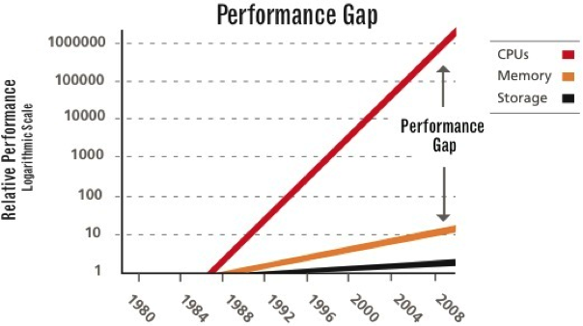
CPU-Memory gap (load less, compute more)
Source: http://www.fusionio.com/white-papers/taming-the-power-hungry-data-center

Slide 12
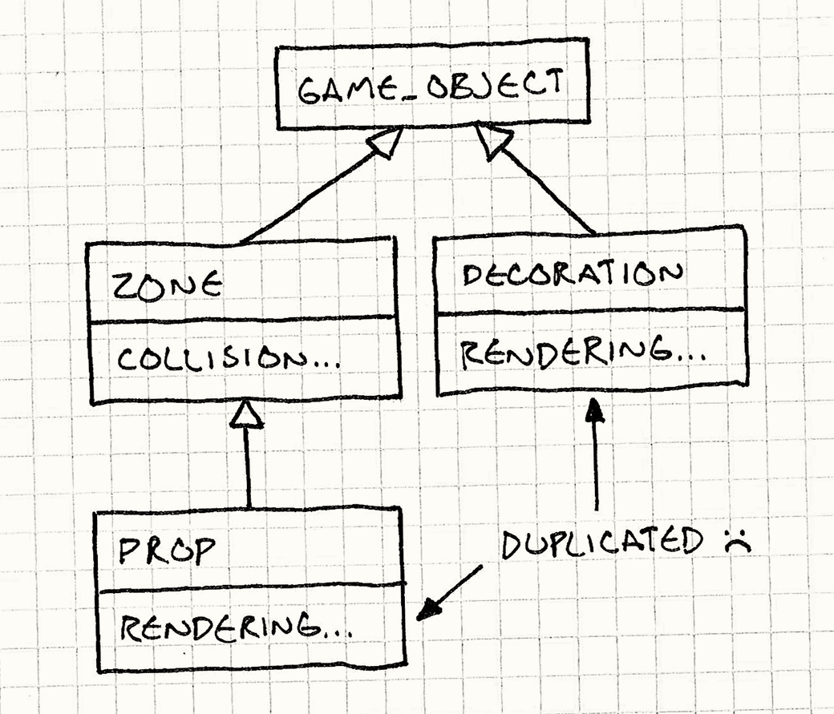
Redundancy in an OOP system
Image source http://gameprogrammingpatterns.com/component.html

Slide 13
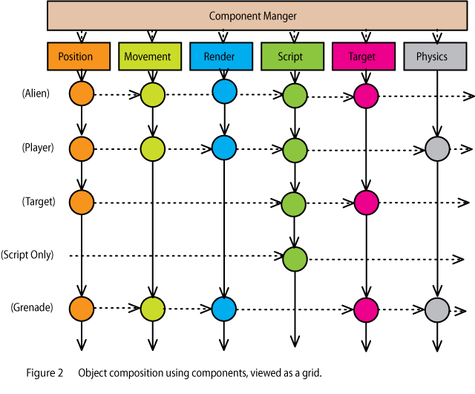
Avoiding redundancy with ECS
Image source http://cowboyprogramming.com/2007/01/05/evolve-your-heirachy/

Slide 14
Additional reading on Entity Component Systems
Foundational knowledge
http://gamearchitect.net/Articles/GameObjects1.html
http://scottbilas.com/files/2002/gdc_san_jose/game_objects_slides.pdf
More recent articles, examples, and guides
http://unity-coding.slashgames.org/category/component-based-entity-systems/
http://cowboyprogramming.com/2007/01/05/evolve-your-heirachy/
http://www.slideshare.net/EmanWebDev/pitfalls-of-object-oriented-programminggcap09
http://www.dataorienteddesign.com/dodmain/dodmain.html
Also has brief but good comments on patterns and anti-patterns

Slide 15
Design pattern “popularity” StackOverflow tags counts (7-’17)

